Slide 1
Virtual Machines, Virtual Machine Monitors and Virtualization Technology

Slide 2
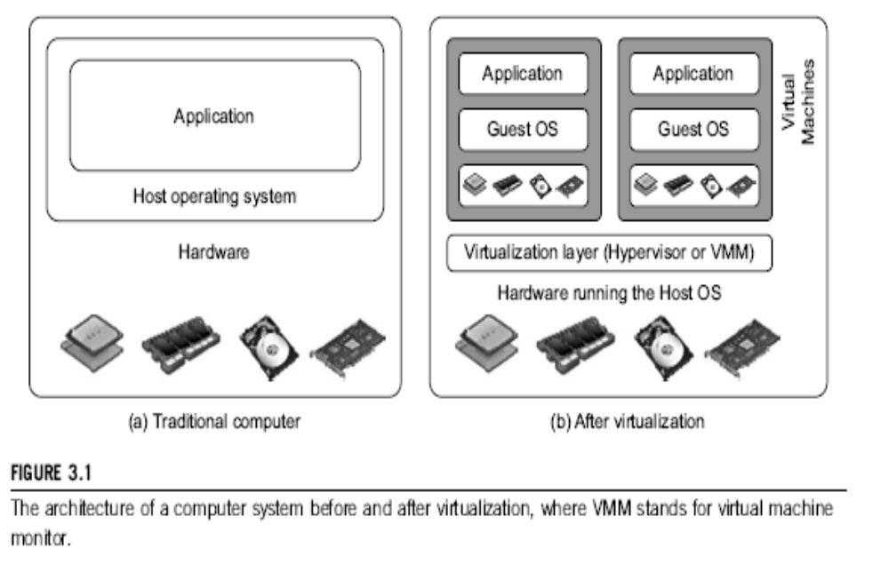
Difference between Traditional Computer and Virtual machines

Slide 3
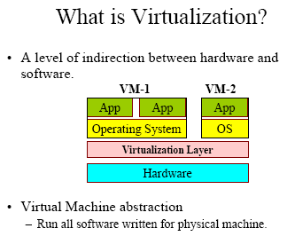
Virtualization is:

Slide 4
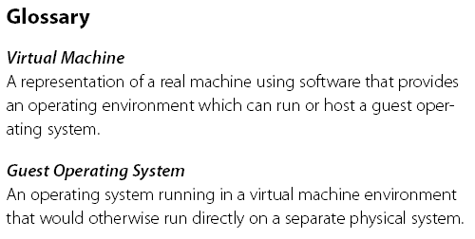
Virtual Machine, Guest Operating System, and VMM (Virtual Machine Monitor) :
The Virtualization layer is the middleware between the underlying hardware and virtual machines represented in the system, also known as virtual machine monitor (VMM).

Slide 5
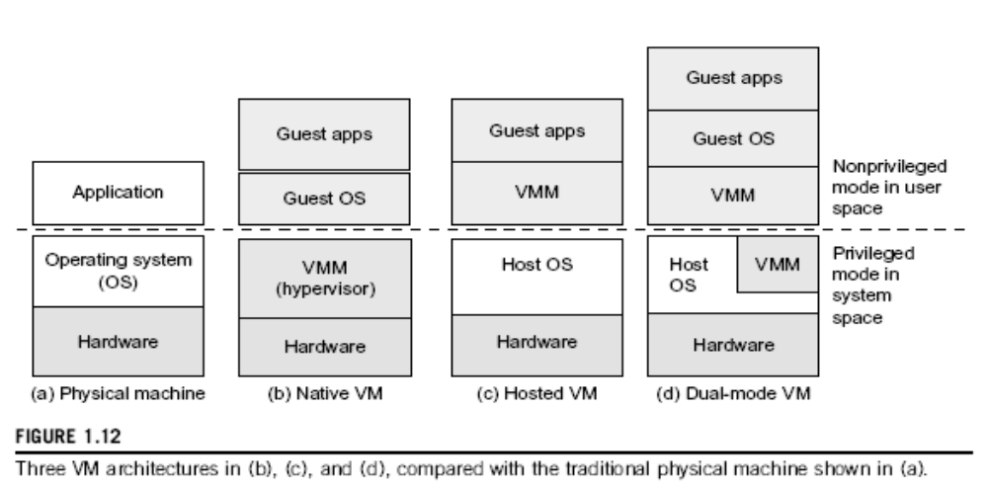

Slide 6
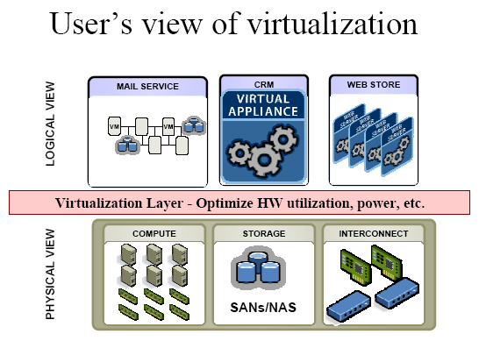

Slide 7
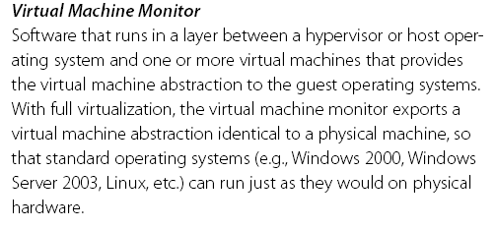
VMM : Virtual Machine Monitor

Slide 8
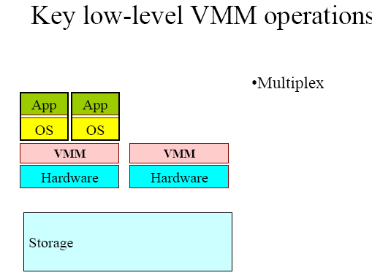
Low-Level VMM Operations (1)

Slide 9
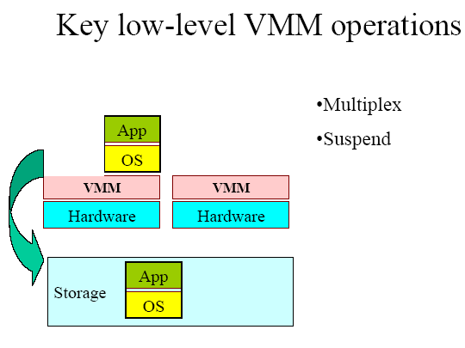
Low-Level VMM Operations (2)

Slide 10
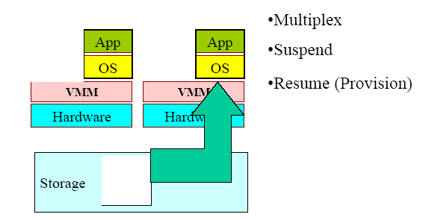
Low-Level VMM Operations (3)

Slide 11
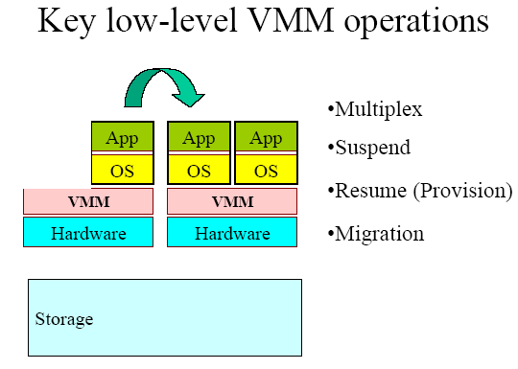
Low-Level VMM Operations (4)

Slide 12
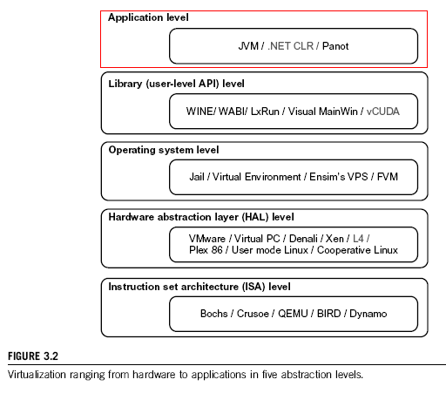

Slide 13
Virtualization at ISA level:
Virtualization is performed by Emulating a given ISA by the ISA of the host machine. For example, MIPS binary code can run on an x-86-based host machine with the help of ISA emulation. Typical systems: Bochs, Crusoe, Qemu, BIRD, Dynamo
Advantage: It can run a large amount of legacy binary codes written for various processors on any given new hardware host machines; Instruction set emulation leads to virtual ISAs created on any hardware machine, i.e. best application flexibility.

Slide 14
Virtualization at ISA level:
Shortcoming & limitation: The basic emulation method is through CODE INTERPRETATION.
An interpreter program interprets the source instructions to target instructions one by one.
- One source instruction may require tens or hundreds of native target instructions to perform its function, which is relatively slow.
- For better performance, DYNAMIC BINARY TRANSLATION is desired (translates basic blocks of dynamic source instructions to target instructions).
- Instruction Set emulation requires binary translation and optimization.
- A Virtual-ISA requires adding a processor-specific software translation layer in the complier.

Slide 15
Virtualization at Hardware Abstraction level:
  Virtualization is performed right on top of the bare hardware.
  It generates virtual hardware environments for VMs, and manages the underlying hardware through virtualization.
  Typical systems: VMware, Virtual PC, Denali, Xen
Advantage: has higher performance and good application isolation
Shortcoming & limitation: very expensive to implement (complexity)

Slide 16
Virtualization at Operating System level:
  It is an abstraction layer between traditional OS and user applications.
  This virtualization creates isolated containers on a single physical server and the OS-instance to utilize the hardware and software in datacenters.
  The containers behaves like real servers.
  OS –level virtualization is commonly used in creating virtual hosting environment to allocate hardware resources among a large number of mutually distrusting users.
  Also used in consolidating servers.
  Typical systems: Jail / Virtual Environment / FVM
Advantage: have minimal starup/shutdown cost, low resource requirement, and high scalability; synchronize VM and host state changes.
Shortcoming & limitation: all VMs at the operating system level must have the same kind of guest OS; poor application flexibility and isolation.

Slide 17
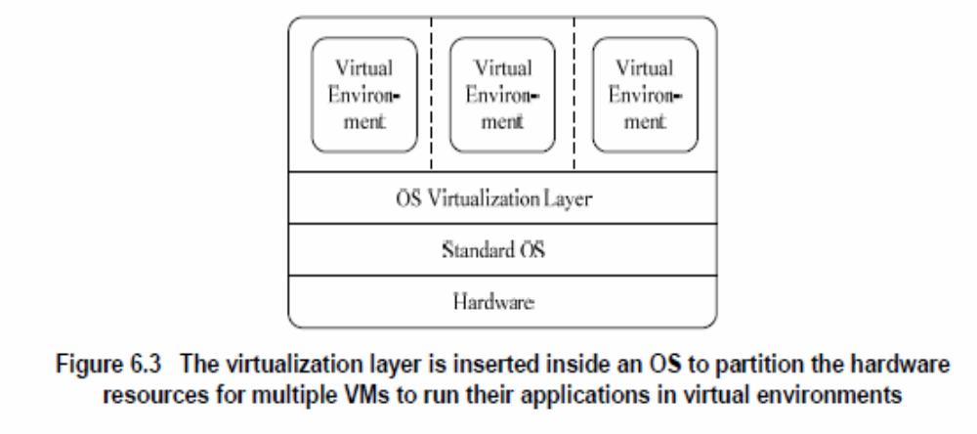
Virtualization at OS Level

Slide 18
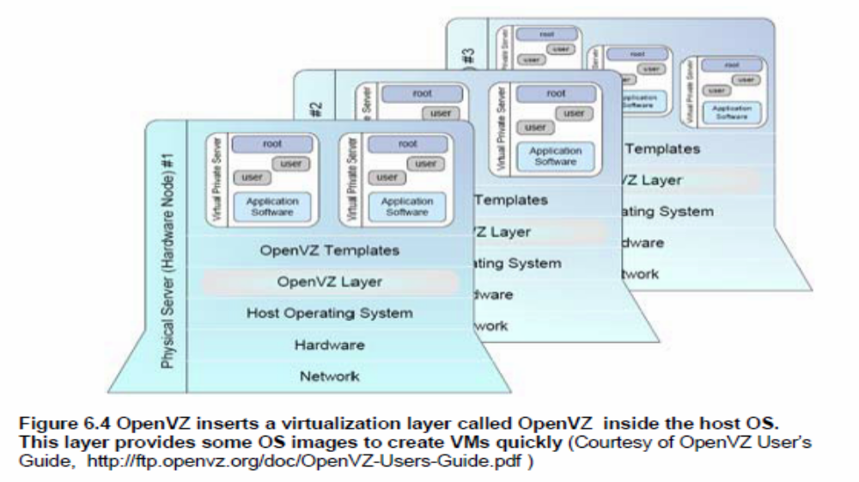
Virtualization for Linux and
Windows NT Platforms

Slide 19
Advantages of OS Extension for Virtualization
VMs at OS level has minimum startup/
shutdown costs
OS-level VM can easily synchronize with its
environment
Disadvantage of OS Extension for Virtualization All VMs in the same OS container must have the same or similar guest OS, which restrict application flexibility of different VMs on the same physical machine.

Slide 20
Library Support level:
Most applications use APIs exported by user-level libraries rather than using lengthy system calls by the OS.
Since most systems provide well-documented APIs, such an interface becomes another candidate for virtualization.
It creates execution environments for running alien programs on a platform rather than creating VM to run the entire operating system.
It is done by API call interception and remapping. Typical systems: Wine, WAB, LxRun , VisualMainWin, vCUDA
Advantage: It has very low implementation effort
Shortcoming & limitation: poor application flexibility and isolation

Slide 21
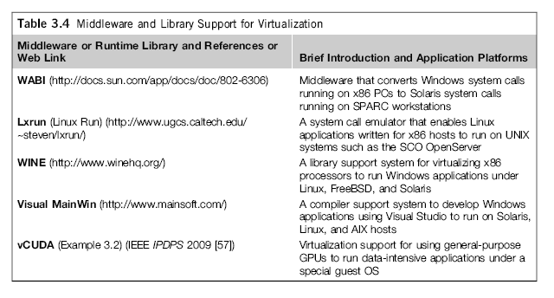
Virtualization with Middleware/Library Support

Slide 22
User-Application level :
It virtualizes an application as a virtual machine.
This layer sits as an application program on top of an operating system and exports an abstraction of a VM that can run programs written and compiled to a particular abstract machine definition.
Also known as process-level virtualization
Typical systems:
JVM , NET CLR , Panot
Advantage: has the best application isolation
Shortcoming & limitation: low performance, low application flexibility and high implementation complexity.

Slide 23
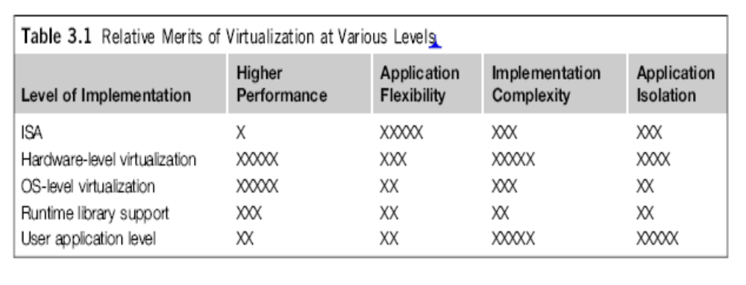

Slide 24
Full Virtualization vs. Para-Virtualization
Full virtualization
Does not need to modify guest OS, and critical instructions are emulated by software through the use of binary translation.
On the other hand, para virtualization needs to modify guest OS, and non-virtualizable instructions are replaced by hypercalls that communicate directly with the hypervisor or VMM.
As of full virtualization, the advantage is no need to modify OS. However, this approach of binary translation slows down the performance a lot.
Para virtualization
Reduces the overhead, but the cost of maintaining paravirtualized OS is high. The improvement depends on the workload. VMware Workstation applies full virtualization, which uses binary translation to automatically modify x86 software on-the-fly to replace critical instructions.
The para virtualization is supported by Xen, Denali and VMware ESX.

Slide 25
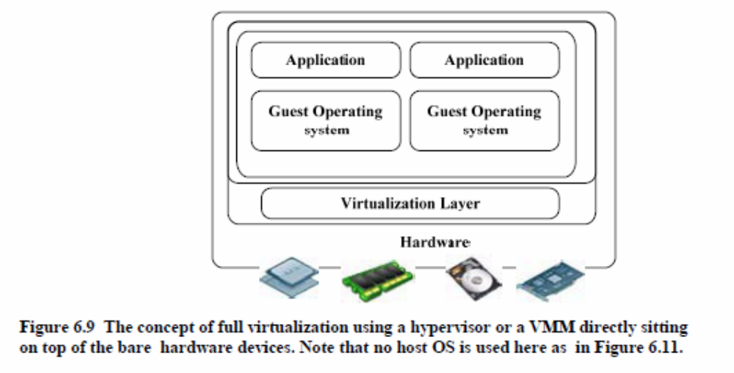
Full Virtualization

Slide 26
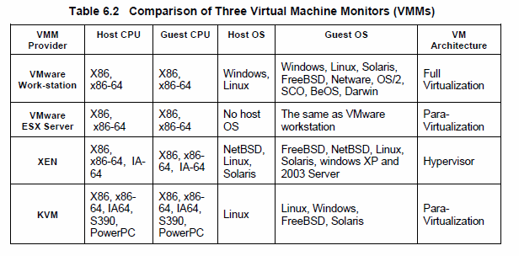
Major VMM and Hypervisor Providers

Slide 27
Hypervisor
A hypervisor is a hardware virtualization technique allowing multiple operating systems, called guests to run on a host machine. This is also called the Virtual Machine Monitor (VMM).
Type 1 hypervisor or the bare metal hypervisor sits on the bare metal computer hardware like the CPU, memory, etc. All the guest operating systems are a layer above the hypervisor. So the hypervisor is the first layer over the hardware. The original CP/CMS hypervisor developed by IBM was of this kind. Examples are Microsoft Hyper-V.
Type 2 or the hosted hypervisor do not run over the bare metal hardware but they run over a host operating system. The hypervisor is the second layer over the hardware. The guest operating systems run a layer over the hypervisor and so they form the third layer. Examples are FreeBSD. The operating system is usually unaware of the virtualization

Slide 28
Virtualization Structures/ Tools and Mechanisms:
Before virtualization, the OS manages the hardware.
After virtualization, A virtualization layer is inserted between the hardware and the OS.
In such a case, the virtualization layer is responsible for converting portions of the real hardware into virtual hardware.
Therefore different OSes can run on the same physical m/c simultaneously.
Depending on the position of the virtualization layer, there are several classes of VM architectures, hypervisor, para-V, host-based V, VMM etc….

Slide 29
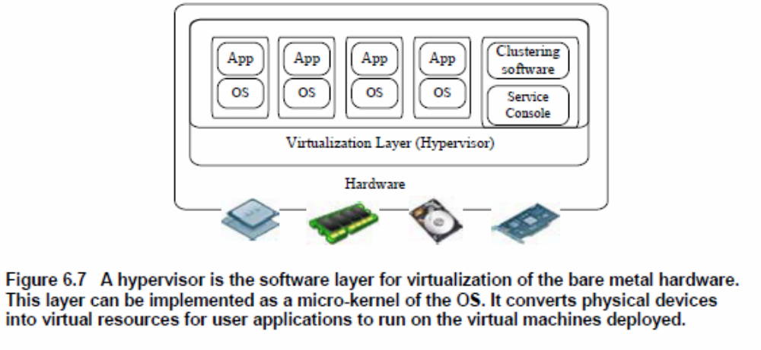
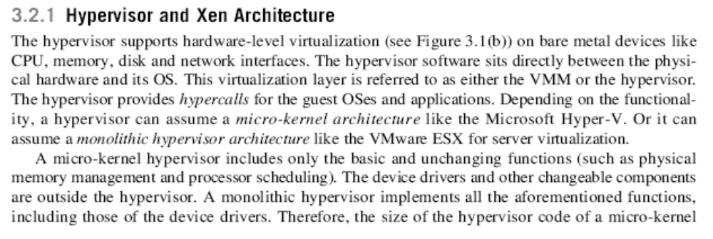
Hypervisor and the XEN Architecture

Slide 30
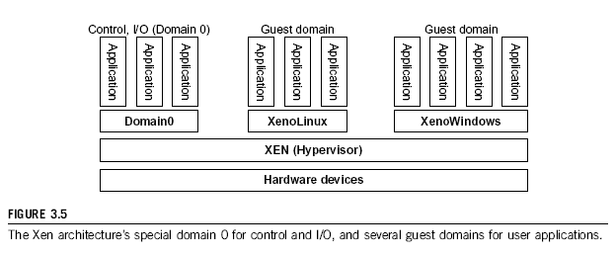
The XEN Architecture (1)

Slide 31
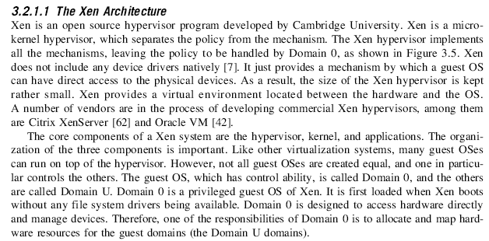
The XEN Architecture (2)

Slide 32
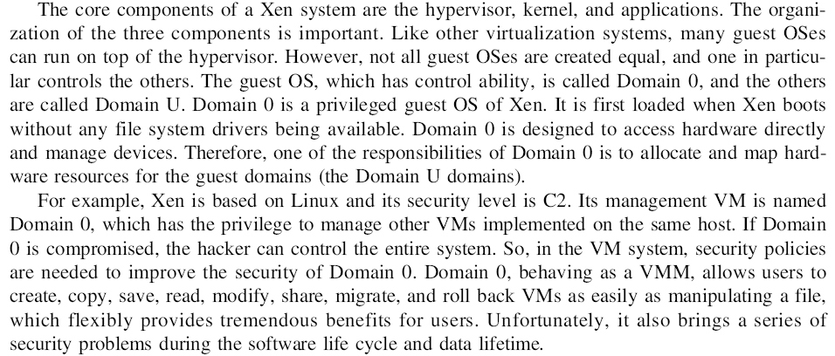
The XEN Architecture (3)

Slide 33
Para-Virtualization
In para-virtualization, the guest operating system has to be modified. Para-virtualization provides specially defined ‘hooks’ to do some tasks in the host and guest operating systems, which would otherwise have been done in a virtual environment, which is slower.
The VMM in a para-virtualized platform is simpler because the critical tasks are now performed in the operating system rather than by the VMM. Since the virtualization overhead decreases the performance increases.
Some of the disadvantages are the compatibility and the portability is reduced because of the modified operating system. Also the cost of maintenance is high because of the deep OS modifications.
Some examples of Para-virtualization are KVM and the XenWindowsGplPv project.

Slide 34
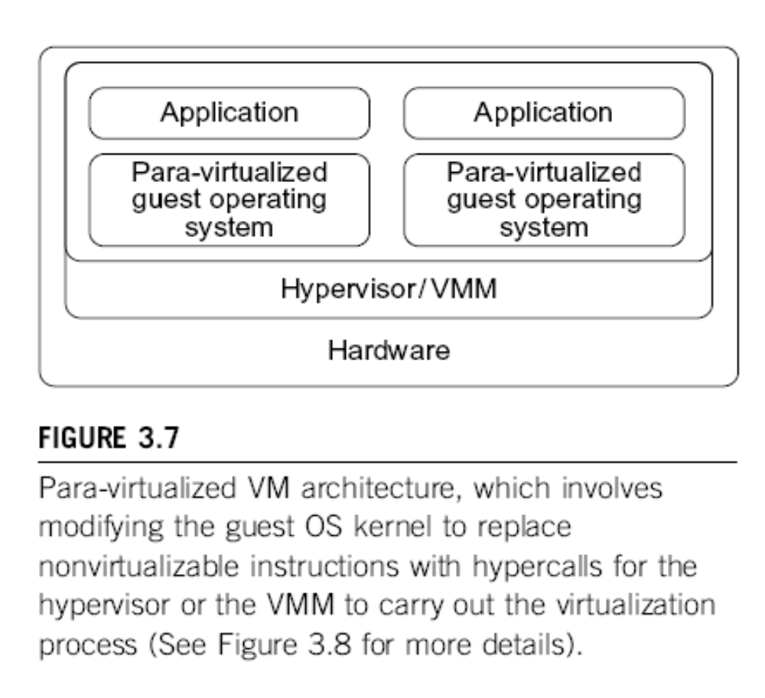
Para-
Virtualization with Compiler Support.
The KVM builds offers kernel-based VM on the Linux
platform, based on para-virtualization

Slide 35
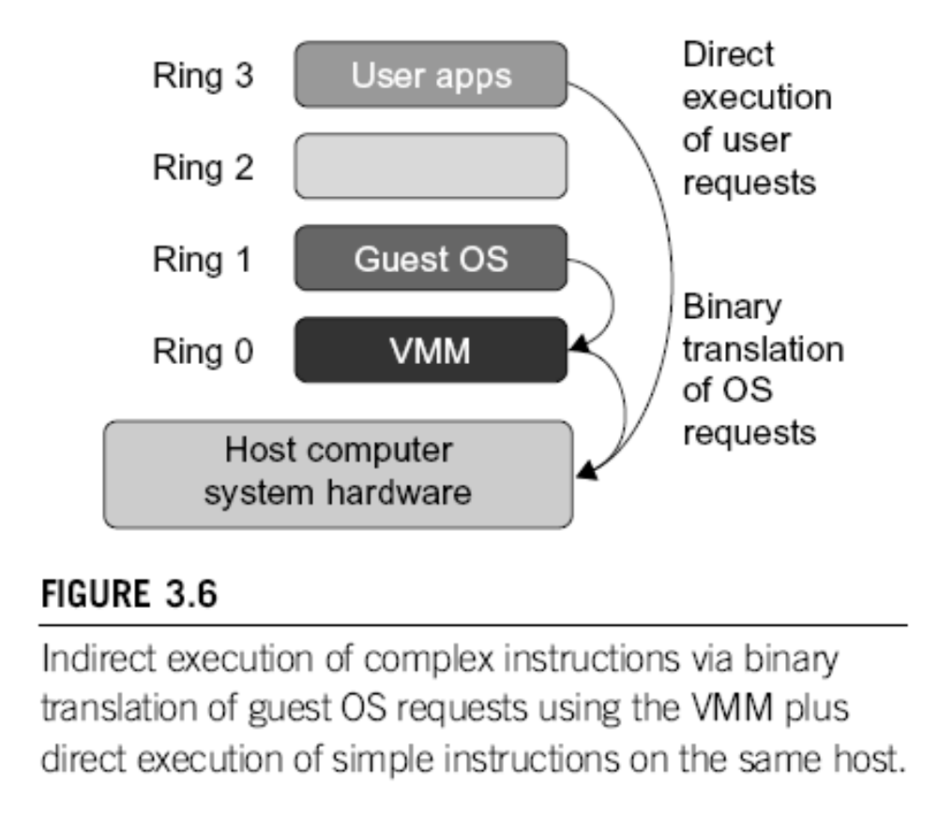
Binary Translation of Guest OS Requests using a VMM:

Slide 36
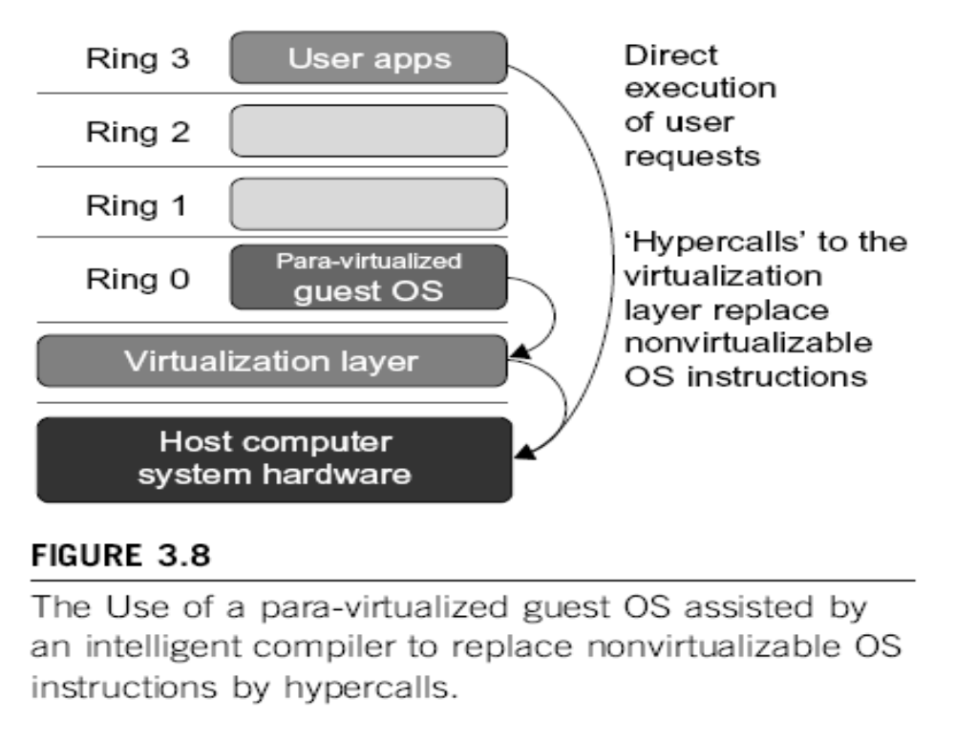

Slide 37
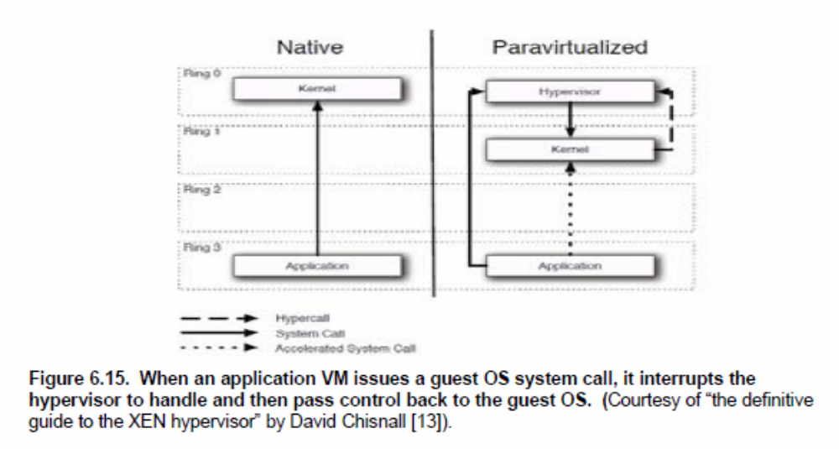
Hypercall Execution

Slide 38
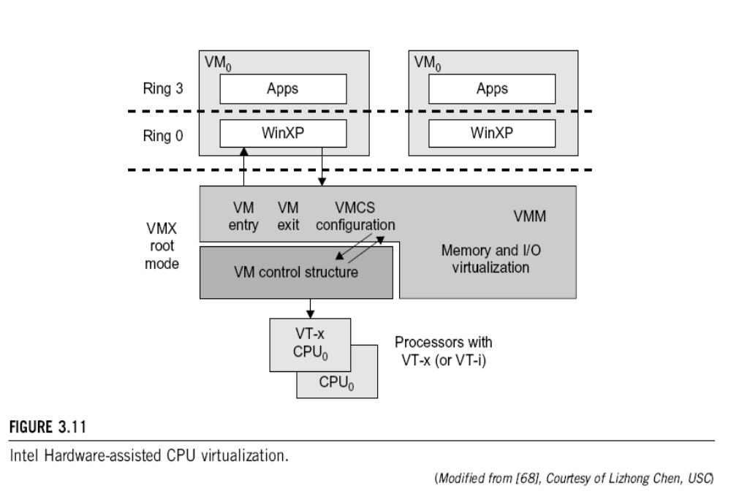

Slide 39
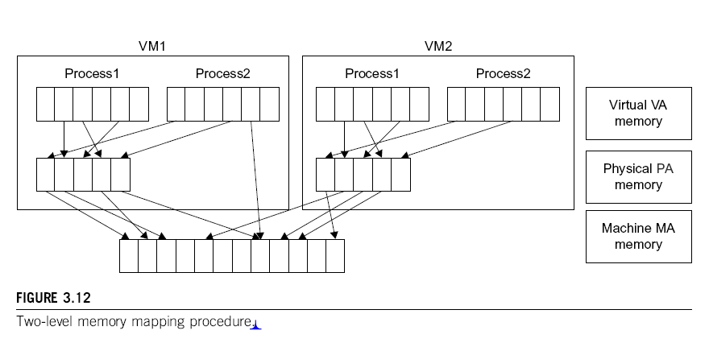

Slide 40
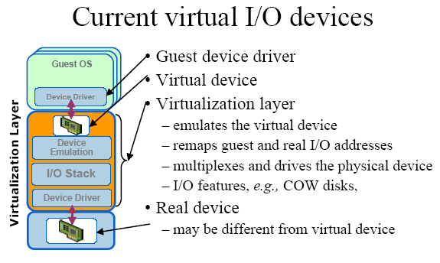

Slide 41
CPU, Memory and I/O Virtualization :
CPU virtualization demands hardware-assisted traps of
sensitive instructions by the VMM
Memory virtualization demands special hardware support
(shadow page tables by VMWare or extended page table by
Intel) to help translate virtual address into physical address
and machine memory in two stages.
I/O virtualization is the most difficult one to realize due to
the complexity if I/O service routines and the emulation
needed between the guest OS and host OS.

Slide 42
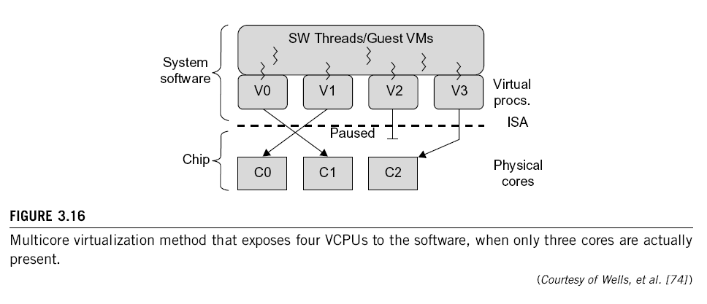
Multi-Core Virtualization:
VCPU vs. traditional CPU
Figure 3.16 Four VCPUs are exposed to the software, whereas,only three cores are actually present. VCPUs V0, V1, and V3 have been transparently migrated, while VCPU V2 has been transparently suspended. (Courtesy of Wells, et al., “Dynamic Heterogeneity and the Need for Multicore Virtualization”, ACM SIGOPS Operating Systems Review, ACM Press, 2009 [68] )

Slide 43
Virtual Cluster Characteristics
The virtual cluster nodes can be either physical or virtual machines. Multiple VMs
running with different OSs can be deployed on the same physical node.
A VM runs with a guest OS, which is often different from the host OS, that manages the resources in the physical machine, where the VM is implemented.
The purpose of using VMs is to consolidate multiple functionalities on the same server. This will greatly enhance the server utilization and application flexibility.
VMs can be colonized (replicated) in multiple servers for the purpose of promoting distributed parallelism, fault tolerance, and disaster recovery.
The size (number of nodes) of a virtual cluster can grow or shrink dynamically, similarly to the way an overlay network varies in size in a P2P network.
The failure of any physical nodes may disable some VMs installed on the failing nodes. But the failure of VMs will not pull down the host system.

Slide 44
Virtual Cores vs. Physical Processor Cores
Physical cores | Virtual cores
The actual physical cores present in the processor. | There can be more virtual cores visible to a single OS than there are physical cores.
More burden on the software to write applications which can run directly on the cores. | Design of software becomes easier as the hardware assists the software in dynamic resource utilization.
Hardware provides no assistance to the software and is hence simpler. | Hardware provides assistance to the software and is hence more complex.
Poor resource management. | Better resource management.
The lowest level of system software has to be modified. | The lowest level of system software need not be modified.

Slide 45
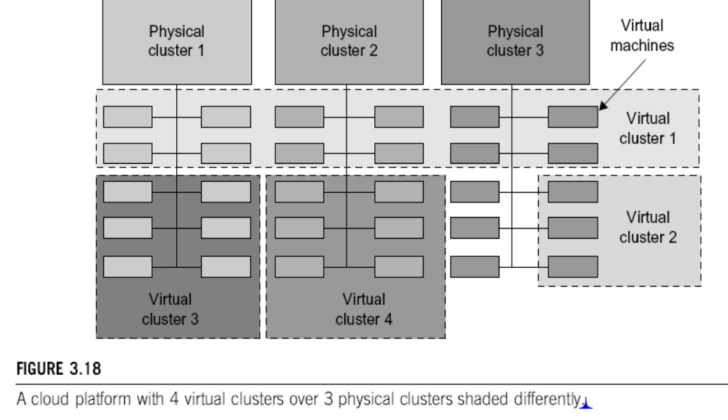
Virtual Clusters vs. Physical Clusters

Slide 46
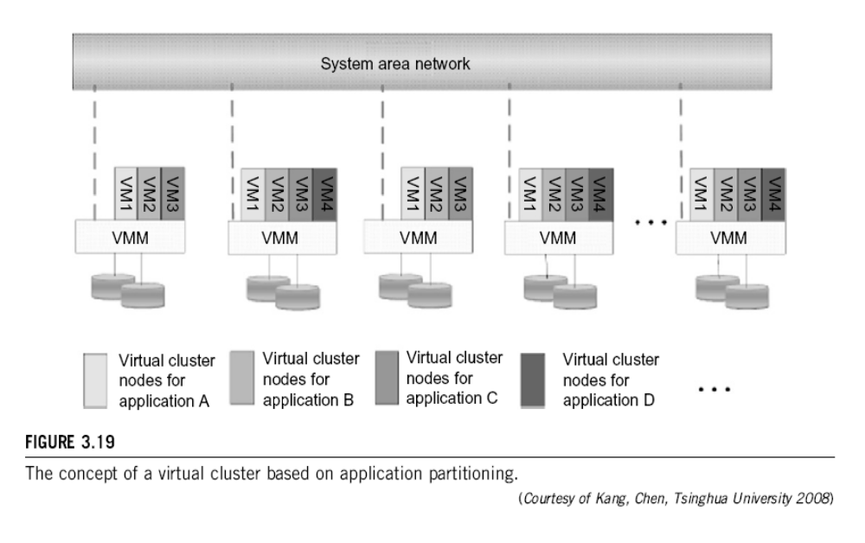

Slide 47
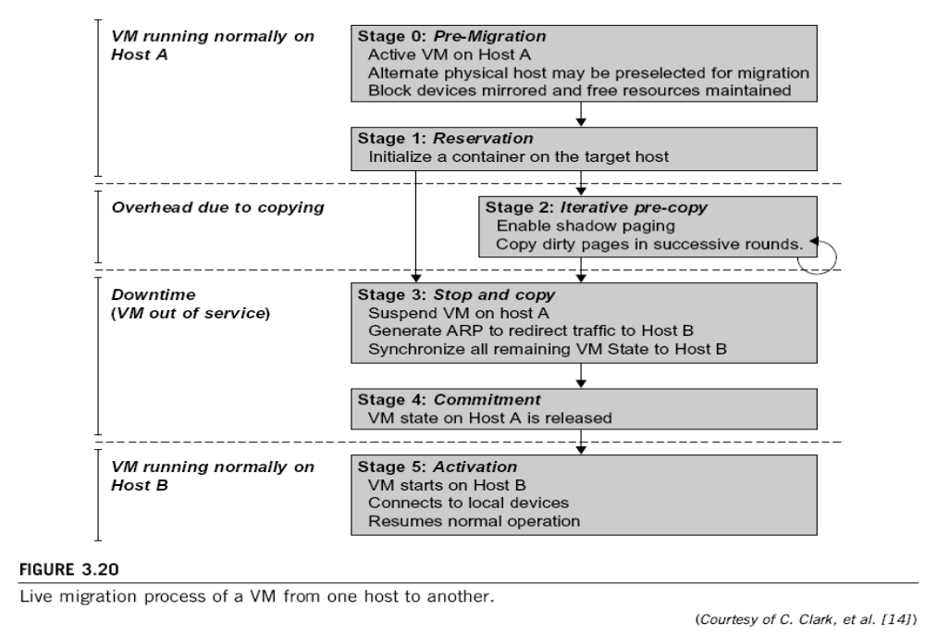
Live Migration of Virtual Machines

Slide 48
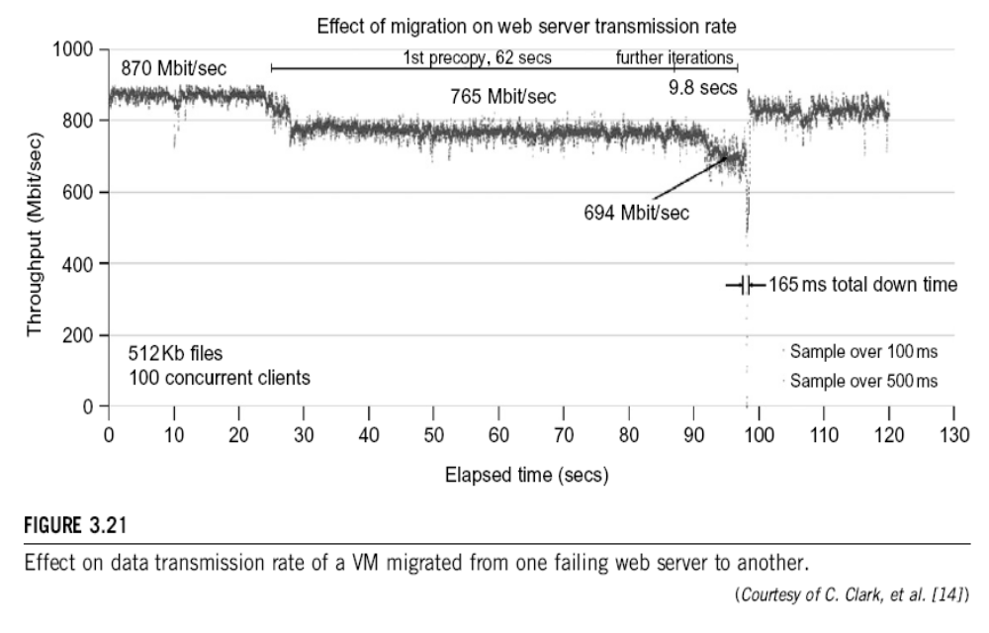

Slide 49
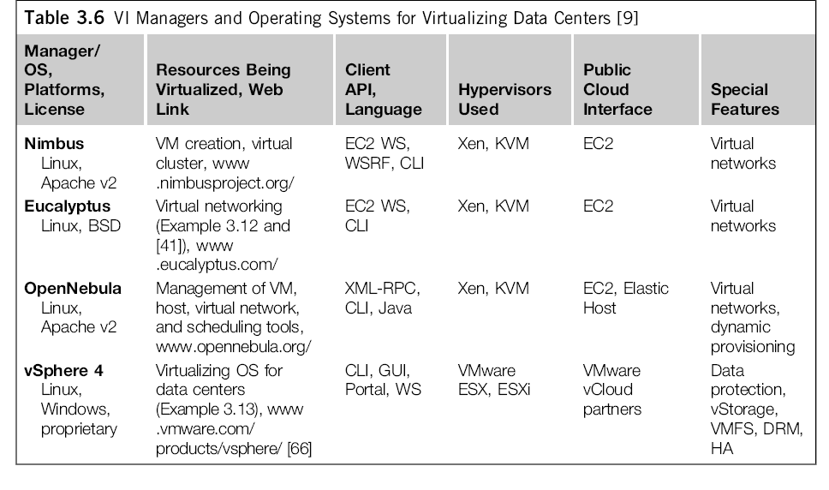
Cloud OS for Building Private Clouds

Slide 50
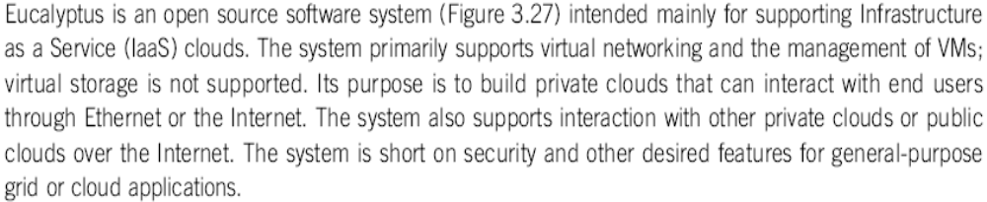
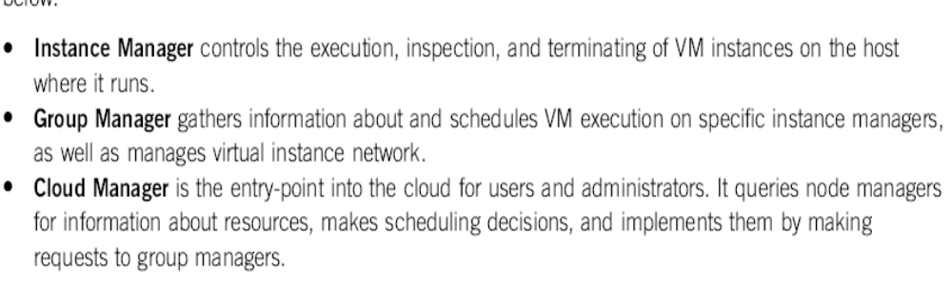
Eucalyptus : An Open-Source OS for Setting Up and Managing Private Clouds

